Slide 1



CLASSIFICATION OF SLEEP DISORDER
USING DEEP LEARNING
KONGU ENGINEERING COLLEGE
PERUNDURAI -638060
DEPARTMENT OF COMPUTER SCIENCE & ENGINEERING
DIABETIC FOOT ULCER DETECTION USING DEEP
LEARNING APPROACHES
PRESENTED BY GUIDED BY
DATE:
Zeroth Review
1
PRESENTED BY
GUIDED BY
SARANKANTH K - 21CSR181 SENTHAN VIGAS M - 21CSR184 SHIVAANI J - 21CSR187
Mr.M.MUTHURAJA
Assistant Professor/CSE
DATE: 17-03-2025

Slide 2
INTRODUCTION
Sleep plays a crucial role in maintaining physical and mental health by supporting body repair and memory retention.
Poor sleep quality or deprivation can result in serious health issues, like cardiovascular diseases, diabetes, and obesity, while also increasing the likelihood of accidents, especially in vulnerable groups like children and older adults.
The prevalence of sleep disorders, including insomnia, sleep apnea, and shift-work sleep disorder, has grown significantly, as indicated by global surveys.

Slide 3
PROBLEM STATEMENT
Many people struggle with sleep problems that affect their health, focus, and energy.
Diagnosing these issues is often slow and can be inaccurate since it relies on manual methods.
With over half of adults unhappy with their sleep, we need better tools to understand and improve sleep quality.

Slide 4
OBJECTIVE
This project aims to enhance the identification of individuals with sleep disorders using a deep learning (DL) algorithm.
By improving the dataset quality, feature selection, and model accuracy, the goal is to develop a robust and efficient system for early detection and classification of sleep-related conditions

Slide 5
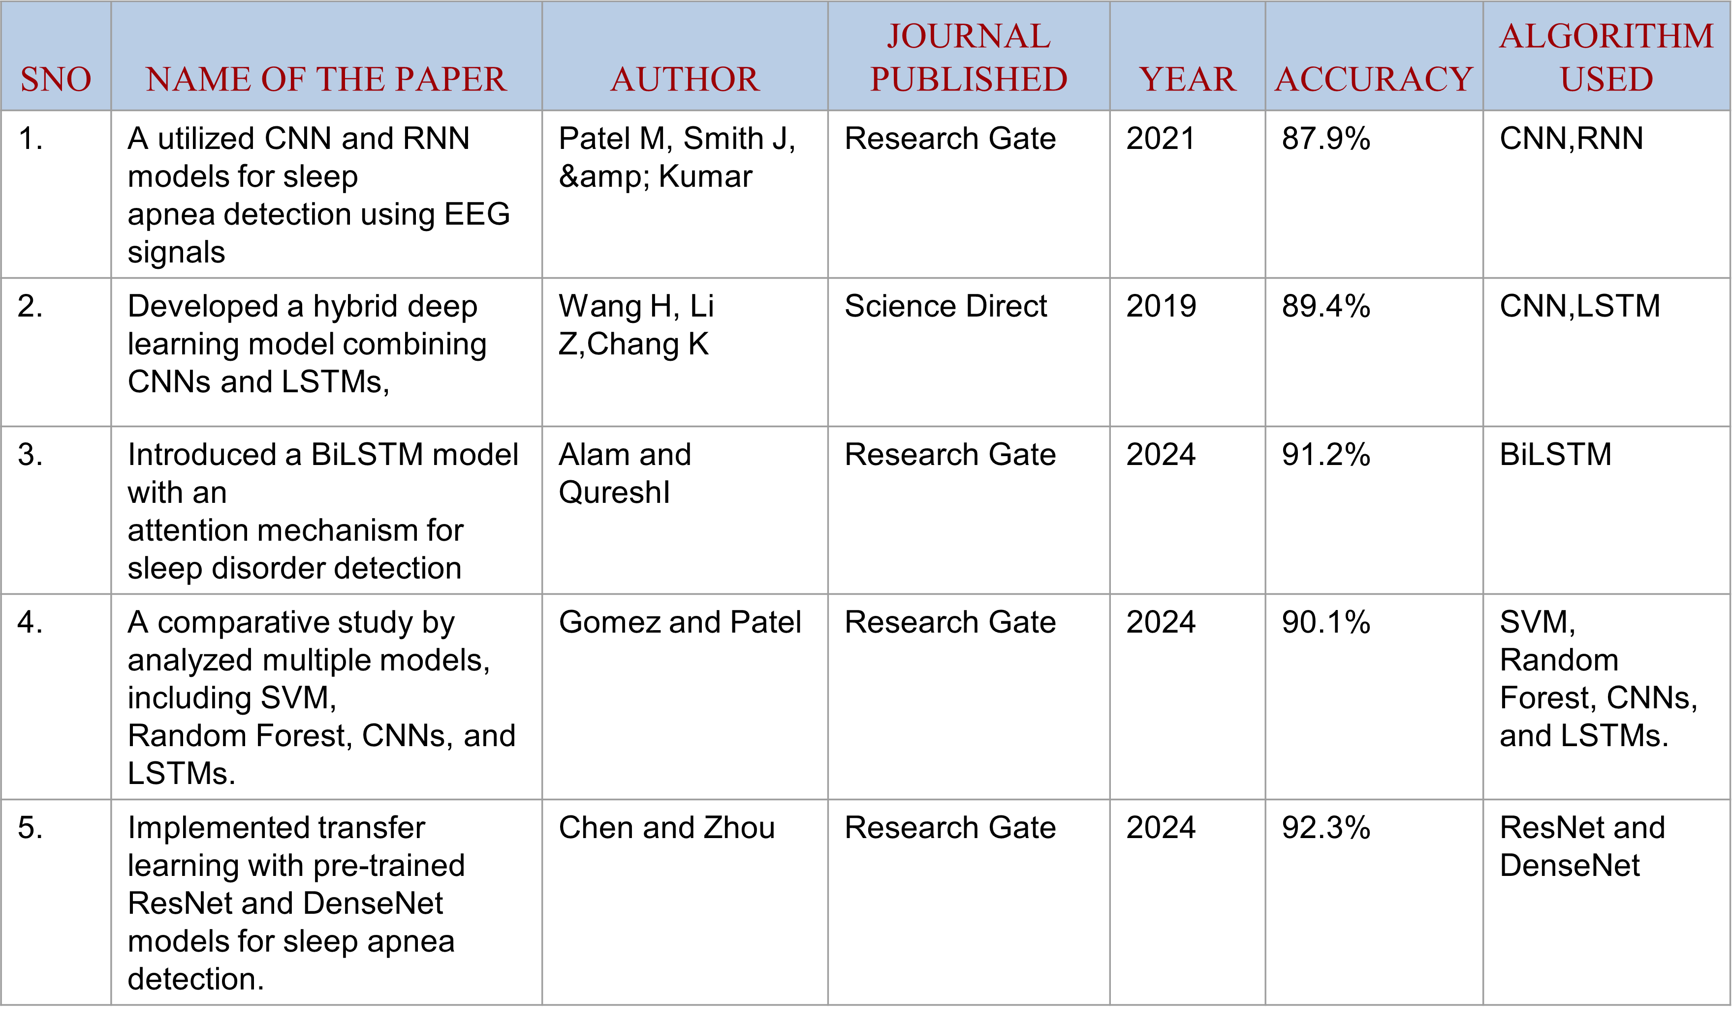
LITERATURE SURVEY

Slide 6
EXISTING SYSTEM
The existing system used algorithms such as,
Support Vector Machine (SVM)
K- Nearest Neighbor (KNN)
Decision Tree (DT)
Random Forest (RF)
Artificial Neural Network (ANN)

Slide 7
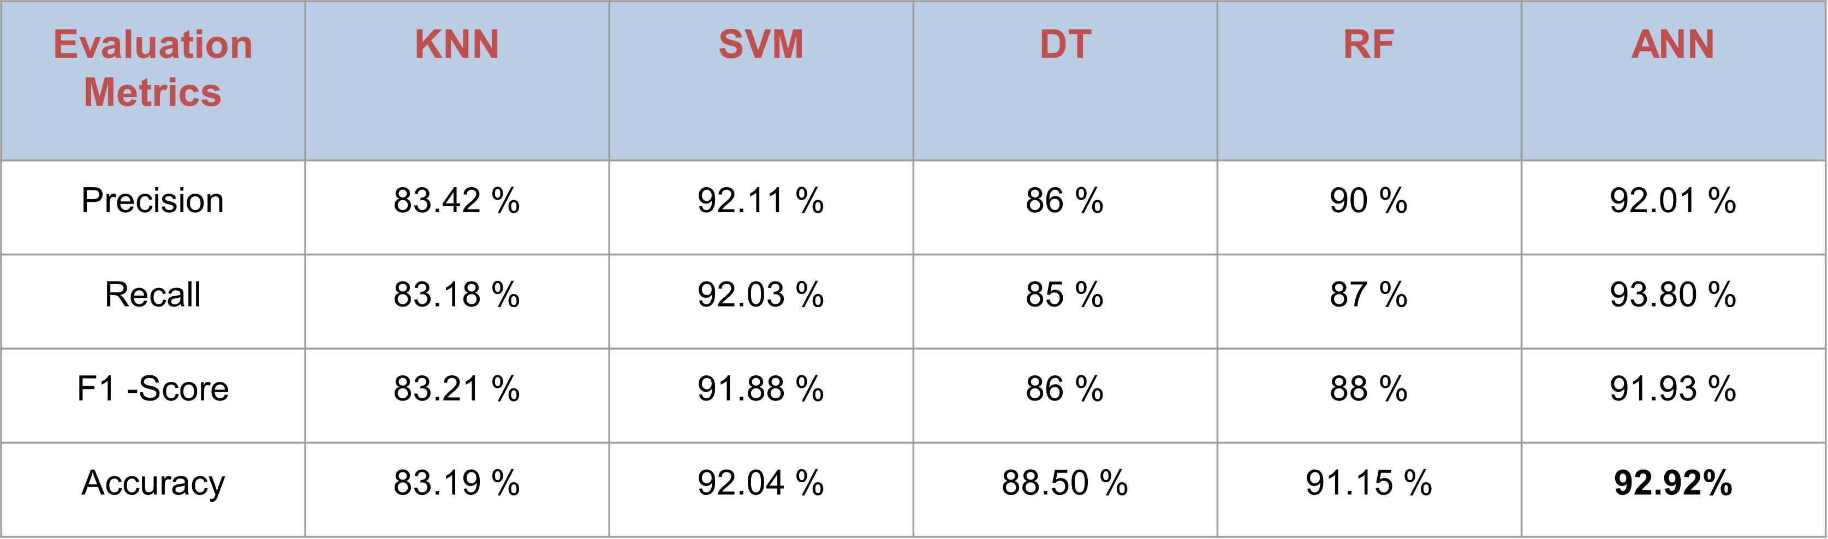
EXISTING SYSTEM
Among these ANN achieved the highest Accuracy of 92 .92 %

Slide 8
EXISTING SYSTEM
DATA COLLECTION
DATA ACQUISITION
DATA PREPROCESSING NORMALIZATION
Model Selection : KNN , SVM , DT, RF, ANN
Model Evaluation
(Metrics : Accuracy , Precision , Recall , F1 -Score)
Classification In Sleep Stages
Fig 1.1: System Architecture

Slide 9
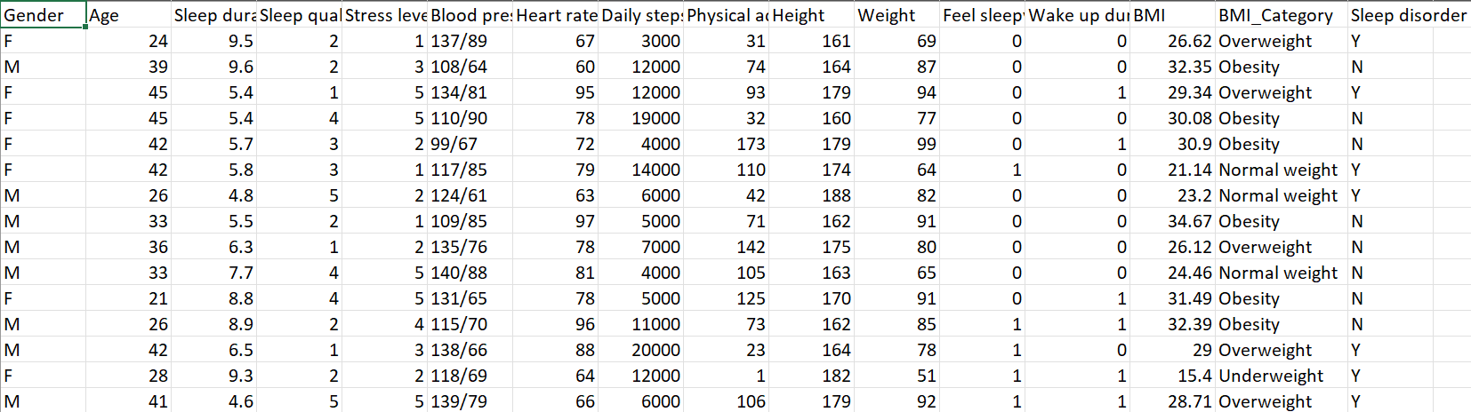
DATASET OVERVIEW

Slide 10
DATASET DESCRIPTION
Dataset gathered from Kaggle
20,000 data in the dataset
Categorized under 15 parameter
Train dataset : 80 %
Test Dataset : 20 %

Slide 11
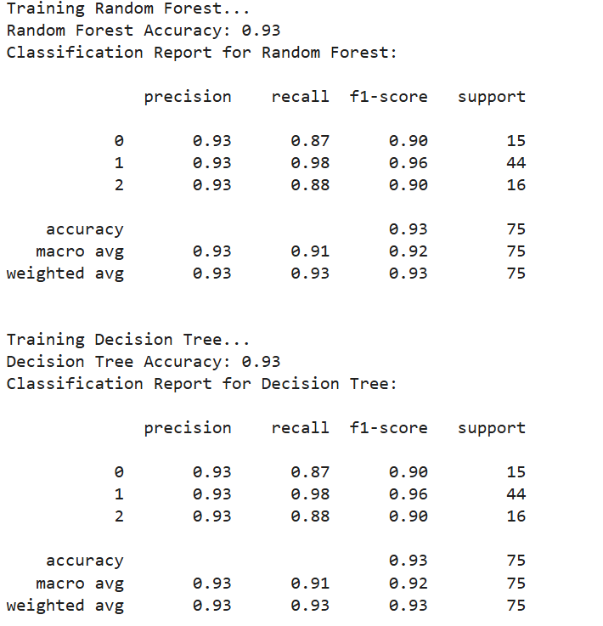
EXISTING SYSTEM IMPLEMENTATION

Slide 12
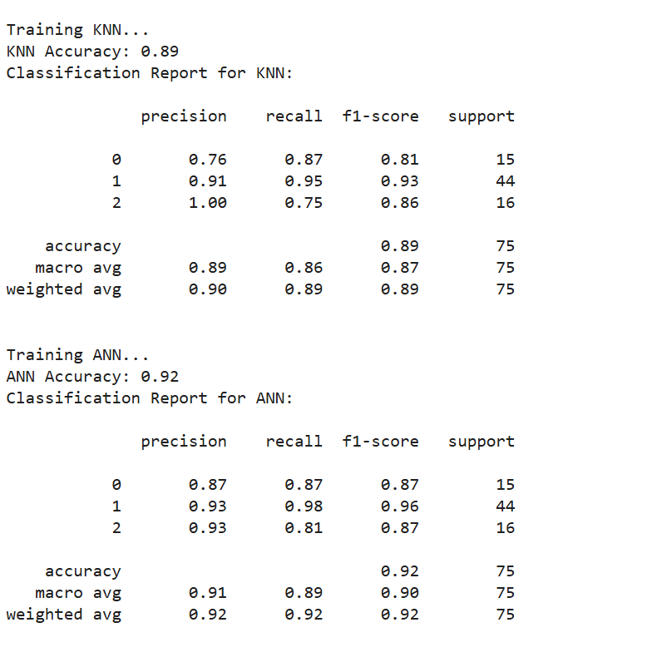

Slide 13
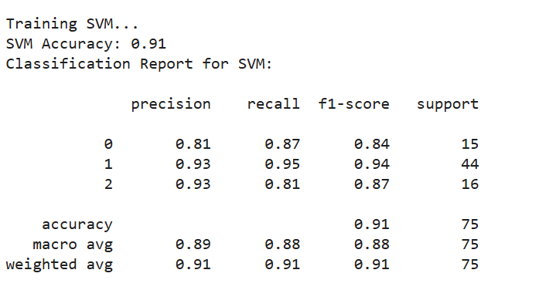

Slide 14
PROPOSED WORK
ALGORITHMS :
Long Short -Term Memory (LSTM)
Recurrent Neural Network (RNN)
Bidirectional Long Short-Term Memory (Bi-LSTM)

Slide 15
1. Long Short-Term Memory (LSTM):
LSTM, an advanced RNN variant, uses input, forget, and output gates to retain long-term dependencies and mitigate vanishing gradients.
It effectively detects sleep disorders by capturing temporal patterns in sequential data.
Fine-tuning, including adjustments to the learning rate and dropout rate, enhances model performance.
This model achieves an accuracy of 77%.

Slide 16
2. Recurrent Neural Network (RNN):
In neural network the information flows in one direction from input to output.
However in RNN information is fed back into the system after each step RNNs allow the network to “remember” past information by feeding the output from one step into next step.
This helps the network understand the context of what has already happened and make better predictions based on that.
This model achieves an accuracy of 76%.

Slide 17
3. Bidirectional Long Short-Term Memory (Bi-LSTM):
Bidirectional Long Short-Term Memory (Bi-LSTM) is an extension of the traditional LSTM (Long Short-Term Memory) network.
Bi-LSTMs allow information to flow from both forward and backward enabling them to capture richer contextual information.
The outputs of both LSTMs are then combined to form the final output. This enhances classification accuracy for detecting different sleep disorders.
Also done Fine-tuning, including adjustments to the learning rate and dropout rate, enhances model performance. This model achieves an accuracy of 77%.

Slide 18


METRICS CONSIDERED FOR EVALUATION
Accuracy
Loss
Precision

Slide 19
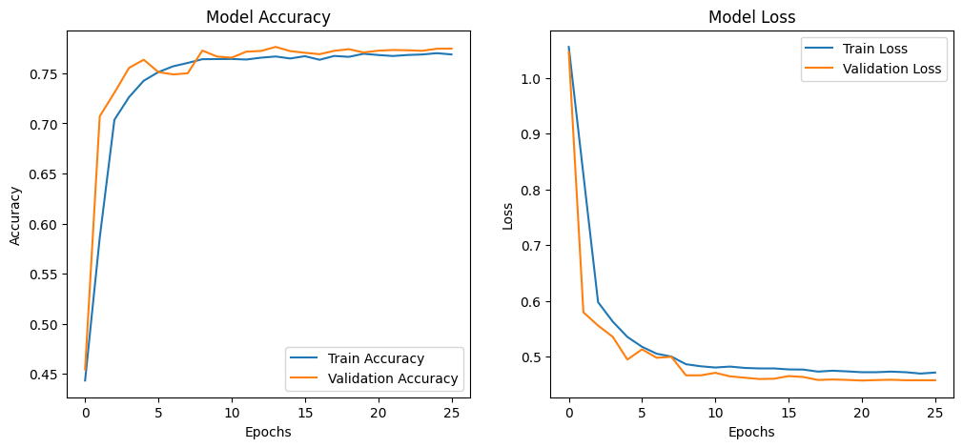
IMPLEMENTATION OF PROPOSED SYSTEM
Fine-Tuned Long Short-Term Memory (LSTM):
Train Accuracy: 76.37%
Validation Accuracy: 77.57%

Slide 20
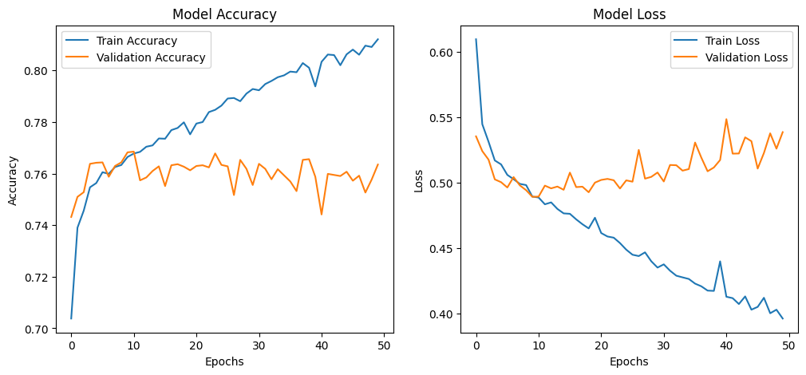
IMPLEMENTATION OF PROPOSED SYSTEM
Recurrent Neural Network :
Train Accuracy: 81.30%
Validation Accuracy: 76.35%

Slide 21
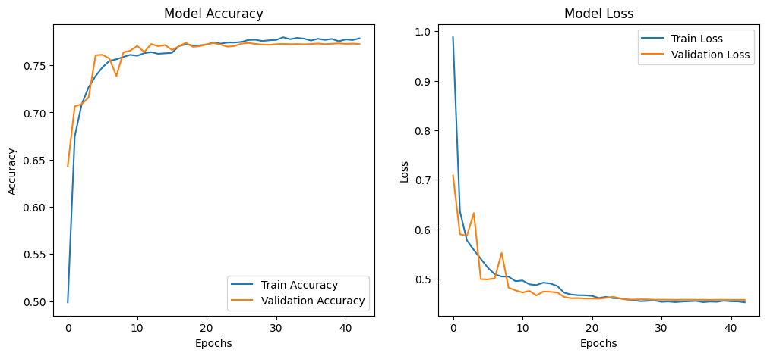
IMPLEMENTATION OF PROPOSED SYSTEM
Fine-Tuned Bidirectional Long Short-Term Memory (Bi-LSTM):
Train Accuracy: 77.44%
Validation Accuracy: 77.22%

Slide 22
PROPOSED SYSTEM OUTPUT
Model Predictions vs Actual Outcomes on Sample Instances
1/1 ━━━━━━━━━━━━━━━━━━━━ 0s 87ms/step Instance 1: Actual = Sleep Apnea, Predicted = None Instance 2: Actual = Insomnia, Predicted = Insomnia Instance 3: Actual = Insomnia, Predicted = Insomnia Instance 4: Actual = None, Predicted = Insomnia Instance 5: Actual = Sleep Apnea, Predicted = Sleep Apnea

Slide 23
PROPOSED SYSTEM OUTPUT
Long Short-Term Memory (LSTM):
Epoch 1/50 225/225 ━━━━━━━━━━━━━━━━━━━━ 2s 6ms/step Epoch 1: Precision: 0.5240, Recall: 0.5283 898/898 ━━━━━━━━━━━━━━━━━━━━ 28s 22ms/step - accuracy: 0.4478 - loss: 1.0371 - val_accuracy: 0.5283 - val_loss: 0.9634
Epoch 2/50 225/225 ━━━━━━━━━━━━━━━━━━━━ 1s 6ms/step Epoch 2: Precision: 0.6772, Recall: 0.6851 898/898 ━━━━━━━━━━━━━━━━━━━━ 21s 23ms/step - accuracy: 0.5503 - loss: 0.9195 - val_accuracy: 0.6851 - val_loss: 0.6546 Epoch 3/50 225/225 ━━━━━━━━━━━━━━━━━━━━ 1s 5ms/step
Epoch 3: Precision: 0.7165, Recall: 0.7274 898/898 ━━━━━━━━━━━━━━━━━━━━ 20s 23ms/step - accuracy: 0.6928 - loss: 0.6278 - val_accuracy: 0.7274 - val_loss: 0.5455 Epoch 4/50 225/225 ━━━━━━━━━━━━━━━━━━━━ 1s 6ms/step
.
.
Epoch 49: Precision: 0.7510, Recall: 0.7584 898/898 ━━━━━━━━━━━━━━━━━━━━ 21s 23ms/step - accuracy: 0.8175 - loss: 0.3946 - val_accuracy: 0.7584 - val_loss: 0.5047 Epoch 50/50 225/225 ━━━━━━━━━━━━━━━━━━━━ 1s 5ms/step
Epoch 50: Precision: 0.7571, Recall: 0.7642 898/898 ━━━━━━━━━━━━━━━━━━━━ 19s 21ms/step - accuracy: 0.8184 - loss: 0.3944 - val_accuracy: 0.7642 - val_loss: 0.5021 225/225 ━━━━━━━━━━━━━━━━━━━━ 1s 6ms/step
LSTM Model Accuracy: 0.7642061281337047
Precision: 0.7570721618910257
Recall: 0.7642061281337047
LSTM Classification Report: precision recall f1-score support 0 0.7154 0.4627 0.5620 2347 1 0.7745 0.9120 0.8377 2433 2 0.7801 0.9092 0.8397 2400
accuracy 0.7642 7180
macro avg 0.7567 0.7613 0.7465 7180
weighted avg 0.7571 0.7642 0.7482 7180

Slide 24
PROPOSED SYSTEM OUTPUT
Recurrent Neural Network (RNN):
Epoch 1/50 225/225 ━━━━━━━━━━━━━━━━━━━━ 1s 4ms/step Epoch 1: Precision: 0.7366, Recall: 0.7432 898/898 ━━━━━━━━━━━━━━━━━━━━ 19s 15ms/step - accuracy: 0.6701 - loss: 0.6819 - val_accuracy: 0.7432 - val_loss: 0.5354
Epoch 2/50 225/225 ━━━━━━━━━━━━━━━━━━━━ 1s 3ms/step Epoch 2: Precision: 0.7501, Recall: 0.7510 898/898 ━━━━━━━━━━━━━━━━━━━━ 12s 14ms/step - accuracy: 0.7354 - loss: 0.5494 - val_accuracy: 0.7510 - val_loss: 0.5241
Epoch 3/50 225/225 ━━━━━━━━━━━━━━━━━━━━ 1s 3ms/step Epoch 3: Precision: 0.7609, Recall: 0.7528 898/898 ━━━━━━━━━━━━━━━━━━━━ 12s 14ms/step - accuracy: 0.7411 - loss: 0.5352 - val_accuracy: 0.7528 - val_loss: 0.5176
.
.
Epoch 49/50 225/225 ━━━━━━━━━━━━━━━━━━━━ 1s 3ms/step Epoch 49: Precision: 0.7507, Recall: 0.7577 898/898 ━━━━━━━━━━━━━━━━━━━━ 11s 12ms/step - accuracy: 0.8101 - loss: 0.3989 - val_accuracy: 0.7577 - val_loss: 0.5259
Epoch 50/50 225/225 ━━━━━━━━━━━━━━━━━━━━ 1s 3ms/step Epoch 50: Precision: 0.7571, Recall: 0.7635 898/898 ━━━━━━━━━━━━━━━━━━━━ 22s 13ms/step - accuracy: 0.8130 - loss: 0.3929 - val_accuracy: 0.7635 - val_loss: 0.5386 225/225 ━━━━━━━━━━━━━━━━━━━━ 1s 4ms/step
RNN Model Accuracy: 0.7635097493036211
Precision: 0.7570941985332597
Recall: 0.7635097493036211
RNN Classification Report: precision recall f1-score support 0 0.7219 0.4512 0.5553 2347 1 0.7747 0.9244 0.8430 2433 2 0.7737 0.9058 0.8345 2400
accuracy 0.7635 7180
macro avg 0.7568 0.7605 0.7443 7180
weighted avg 0.7571 0.7635 0.7461 7180

Slide 25
PROPOSED SYSTEM OUTPUT
Bidirectional Long Short-Term Memory (Bi-LSTM):
Epoch 1/50 225/225 ━━━━━━━━━━━━━━━━━━━━ 3s 11ms/step Epoch 1: Precision: 0.6773, Recall: 0.7007 898/898 ━━━━━━━━━━━━━━━━━━━━ 47s 41ms/step - accuracy: 0.4920 - loss: 0.9631 - val_accuracy: 0.7007 - val_loss: 0.5830
Epoch 2/50 225/225 ━━━━━━━━━━━━━━━━━━━━ 3s 13ms/step Epoch 2: Precision: 0.7162, Recall: 0.7248 898/898 ━━━━━━━━━━━━━━━━━━━━ 36s 40ms/step - accuracy: 0.7021 - loss: 0.5871 - val_accuracy: 0.7248 - val_loss: 0.5509
Epoch 3/50 225/225 ━━━━━━━━━━━━━━━━━━━━ 3s 13ms/step Epoch 3: Precision: 0.7301, Recall: 0.7311 898/898 ━━━━━━━━━━━━━━━━━━━━ 42s 41ms/step - accuracy: 0.7223 - loss: 0.5586 - val_accuracy: 0.7311 - val_loss: 0.5400
.
.
Epoch 49/50 225/225 ━━━━━━━━━━━━━━━━━━━━ 2s 8ms/step Epoch 49: Precision: 0.7469, Recall: 0.7507 898/898 ━━━━━━━━━━━━━━━━━━━━ 42s 39ms/step - accuracy: 0.9221 - loss: 0.1729 - val_accuracy: 0.7507 - val_loss: 0.9112
Epoch 50/50 225/225 ━━━━━━━━━━━━━━━━━━━━ 2s 8ms/step Epoch 50: Precision: 0.7511, Recall: 0.7553 898/898 ━━━━━━━━━━━━━━━━━━━━ 40s 38ms/step - accuracy: 0.7744 - loss: 0.1644 - val_accuracy: 0.7722 - val_loss: 0.9329 225/225 ━━━━━━━━━━━━━━━━━━━━ 2s 10ms/step
BiLSTM Model Accuracy: 0.77.22924791086351
Precision: 0.7511184403000025
Recall: 0.7552924791086351
BiLSTM Classification Report: precision recall f1-score support 0 0.6358 0.5884 0.6112 2347 1 0.8099 0.8389 0.8241 2433 2 0.8043 0.8337 0.8187 2400
accuracy 0.77.22 7180
macro avg 0.7500 0.7537 0.7514 7180
weighted avg 0.7511 0.7553 0.7527 7180

Slide 26
CONCLUSION AND FUTURE ENHANCEMENT
Fine-Tuned LSTM achieves the highest accuracy of 77.57%, followed by RNN at 76.35% and Bi-LSTM at 75.52%
This result indicates that Fine-Tuned LSTM outperforms the other models in terms of accuracy.
Deploying the model in a real-time system enables live predictions and decision-making. Integration with IoT, cloud, or mobile apps enhances accessibility and automation.

Slide 27
REFERENCES
[1] Patel M, Smith J, & Kumar A, “CNN and RNN Models for Sleep Apnea Detection Using EEG Signals,” [2021].
[2] Wang H, Li Z, Chang K, “Hybrid Deep Learning Model Combining CNNs and LSTMs for Sleep Disorder
Detection,” [2022].
[3] Alam and Qureshi, “BiLSTM Model with Attention Mechanism for Sleep Disorder Detection,”[2021].
[4] Gomez and Patel, “Comparative Study of Machine Learning Models for Sleep Disorder Detection,”[2020].
[5] Chen and Zhou, “Transfer Learning with ResNet and DenseNet for Sleep Apnea Detection,”[2022].

Slide 28
THANK YOU

